Slide 1
Capstone Project
Car accident severity

Slide 2
Background
The whole world suffers car accidents. Over 5 millions car accidents take place every year in the United States of America. Driving a car is always risky and the results of car accidents range from minor injuries to death. This Project aims to predict the severity of car accidents taking into account different factors such as weather conditions, light conditions or whether the driver was under the influence of alcohol.

Slide 3
Introduction
Business Problem
The problem statement is to predict severity of road accidents caused by a wide variety of factors in Seattle City. It will be very useful to provide with an accurate prediction to the following audiences:
City administration
Seattle city administrators can take precautions based on this data. They can set up speed limits and other precautionary measures such as speed breakers.
Hospitals
Hospitals can be placed near high accident areas in order to help quickly to any victim.
All of us
According to the weather, road conditions or locations we can be aware of the risks and drive carefully or even change our route.

Slide 4
Data
The data used for this project is a database of the details of accidents in Seattle City including types and severity. Data Here:
https://s3.us.cloud-object-storage.appdomain.cloud/cf-courses-data/CognitiveClass/DP0701EN/version-2/Metadata.pdf
This Data set consists of 38 columns. We can drop many columns due to its irrelevance when trying to predict the severity of an accident or its high amount of missing data.

Slide 5
Relevant Data
Data | Description
Address type | where the accident took place
Collision type | (Vehicle Rollover, Rear-end Collision, Side-impact Collision, Head-on collision)
Vehicle Count | The number of vehicles involved in the collision
Weather | (Dry, wet , fog, etc.)
Road conditions | (Wet, Dry, etc.)
Light conditions | (Daylight, Dark-Street lights on , etc.)
Influences | The driver was under the influence of alcohol
Hit parked car | Whether the accident involved hitting a parked car
junction type | Category of junction at which collision took place

Slide 6
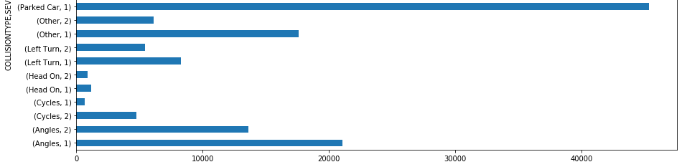
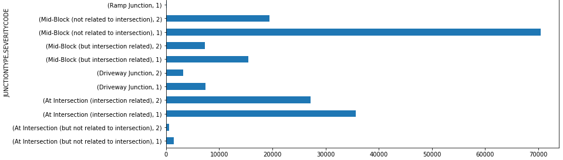
Methodology Section
Exploratory data analysis examples:
More severity when the accident involves hitting a parked car
Which junction is more dangerous? (look at the graph)

Slide 7
Convertion to numerical values
 | SEVERITYCODE | ADDRTYPE | COLLISIONTYPE | VEHCOUNT | JUNCTIONTYPE | UNDERINFL | WEATHER | ROADCOND | LIGHTCOND | HITPARKEDCAR
180975 | 1 | Block | Sideswipe | 1 | Mid-Block (not related to intersection) | N | Raining | Wet | Dusk | N
22948 | 1 | Intersection | Right Turn | 2 | At Intersection (intersection related) | 0 | Raining | Wet | Daylight | N
40362 | 1 | Block | Parked Car | 2 | Mid-Block (not related to intersection) | 0 | Raining | Wet | Daylight | N
25786 | 1 | Block | Rear Ended | 2 | Mid-Block (but intersection related) | 0 | Clear | Dry | Daylight | N
88320 | 1 | Block | Parked Car | 2 | Mid-Block (not related to intersection) | N | Overcast | Wet | Dusk | N
 | SEVERITYCODE | VEHCOUNT | UNDERINFL_N | UNDERINFL_Y | LIGHTCOND_Dark - No Street Lights | LIGHTCOND_Dark - Street Lights Off | LIGHTCOND_Dark - Street Lights On | LIGHTCOND_Dark - Unknown Lighting | LIGHTCOND_Dawn | LIGHTCOND_Daylight | COLLISIN TYPE | COLLISIONTYPE_Head On | COLLISIONTYPE_Left Turn | COLLISIONTYPE_Other | COLLISIONTYPE_Parked Car | COLLISIONTYPE_Rear Ended | COLLISIONTYPE_Right Turn | COLLISIONTYPE_Sideswipe
180975 | 1 | 1 | 1 | 0 | 0 | 0 | 0 | 0 | 0 | 0 | 0 | 0 | 0 | 0 | 0 | 0 | 0 | 1
22948 | 1 | 2 | 1 | 0 | 0 | 0 | 0 | 0 | 0 | 1 | 0 | 0 | 0 | 0 | 0 | 0 | 1 | 0
40362 | 1 | 2 | 1 | 0 | 0 | 0 | 0 | 0 | 0 | 1 | 0 | 0 | 0 | 0 | 1 | 0 | 0 | 0
25786 | 1 | 2 | 1 | 0 | 0 | 0 | 0 | 0 | 0 | 1 | 0 | 0 | 0 | 0 | 0 | 1 | 0 | 0
88320 | 1 | 2 | 1 | 0 | 0 | 0 | 0 | 0 | 0 | 0 | 0 | 0 | 0 | 0 | 1 | 0 | 0 | 0
Numbers are better to handle in machine Learning

Slide 8
Conclusions
1
We found main factors to cause severity in accidents which are: Address type where the accident took place, the collision type, the number of vehicles involved in the accident, the junction type where the accident occurred, whether the driver was under the influence of alcohol, the weather conditions, road conditions and light conditions during the accidents, and whether the accident involved hitting a parked car.
2
This is a classification problem. In consequence I used three classification machine learning algorithms so as to predict the severity of a car accident in Seattle. This algorithms are Support Vector Machine(SVM), Logistic Regression (LR) and Decision Tree. As we can see in the code section (look in GitHub), the SVM provides a better performance.
Helps
To:
Seattle city administrators can take precautions based on this data. They can set up speed limits and other precautionary measures such as speed breakers.
Hospitals can be placed near high accident areas in order to help quickly to any victim.
Due to the weather, road conditions or locations we can be aware about dangers an drive carefully or even change our route towards our destiny.

